Slide 2
Equipment required

Slide 3
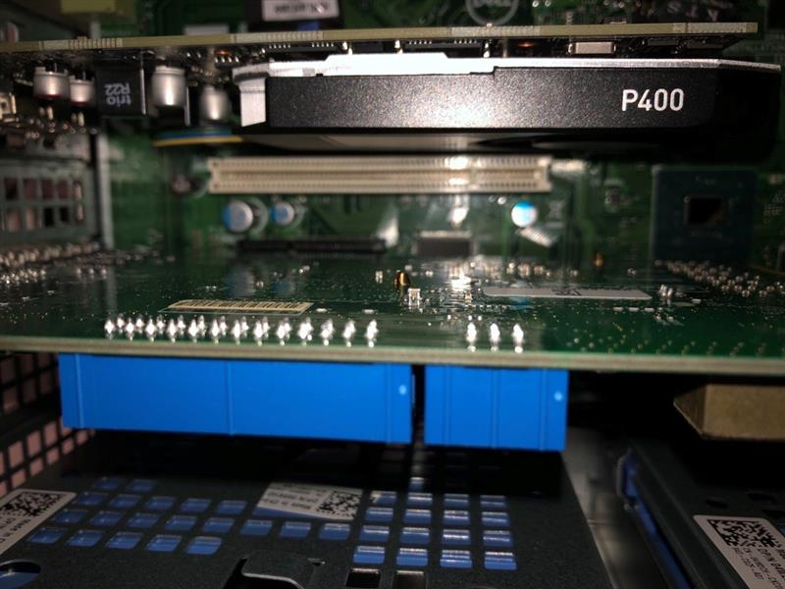
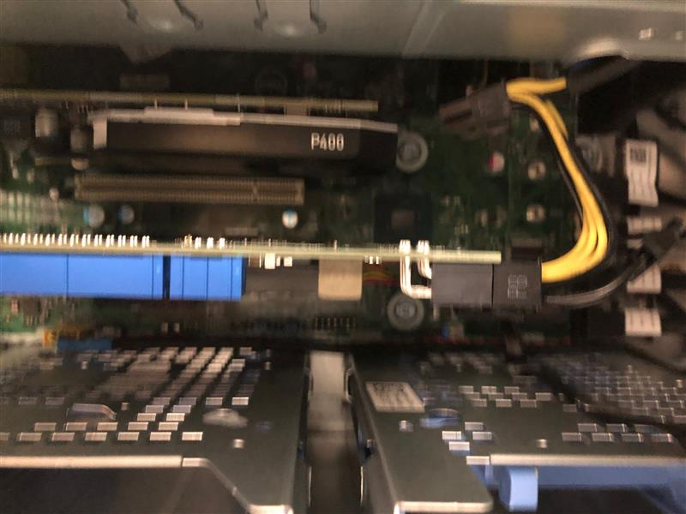
Frame Grabber card
PCI connection
Insert Euresys board in the PC.
Connect the power supply of the board.
Power supply connected to the PC power supply

Slide 4
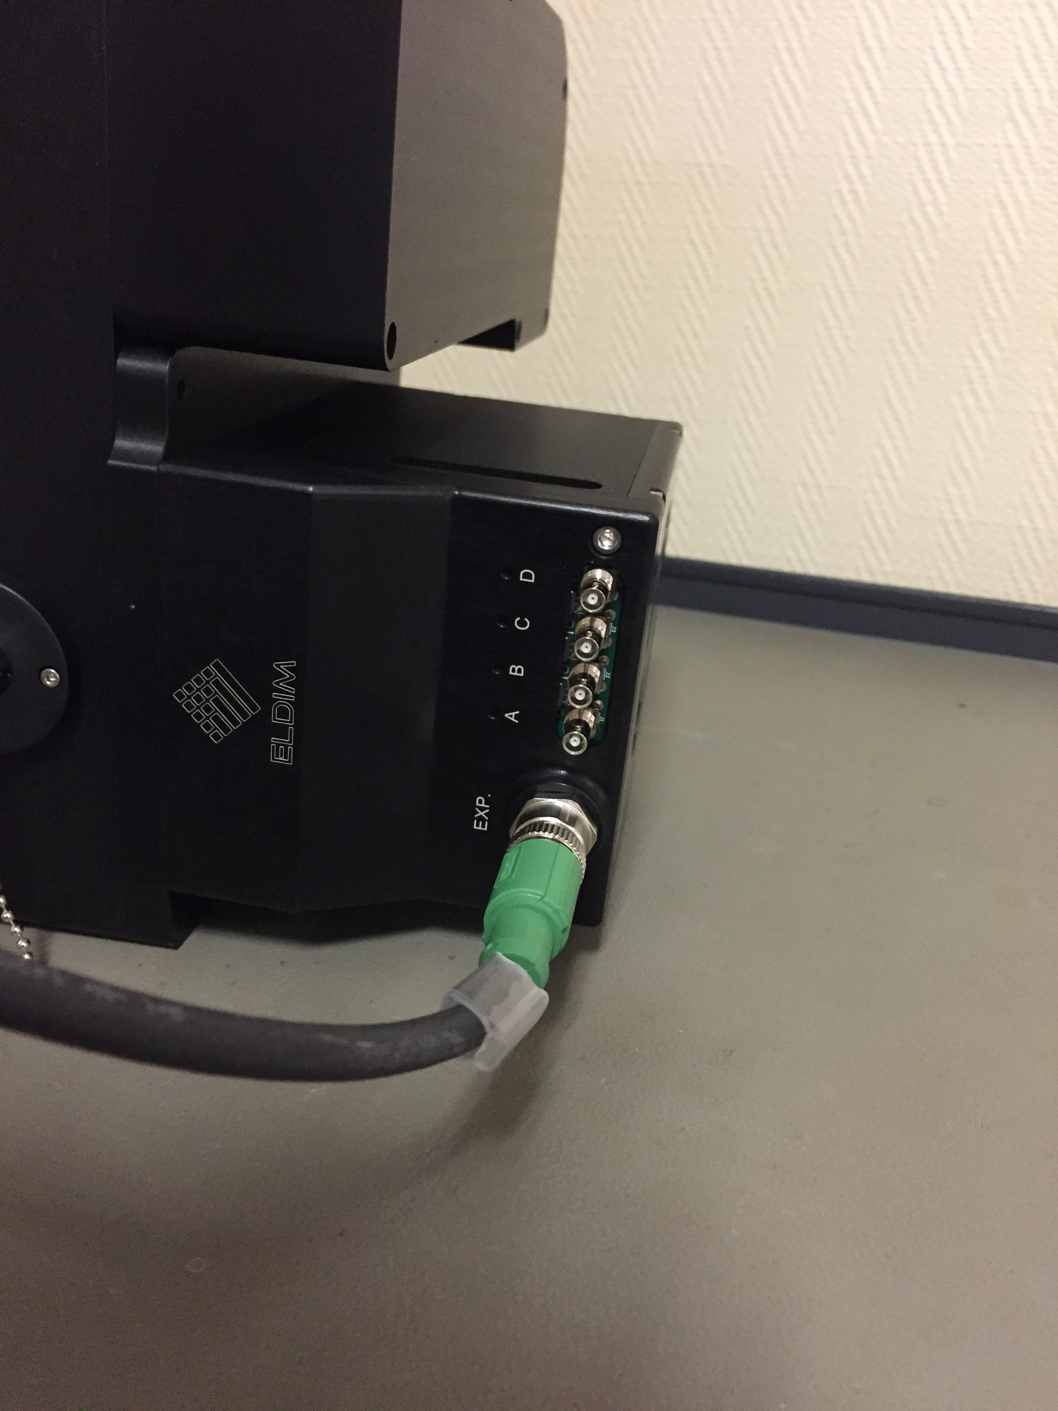
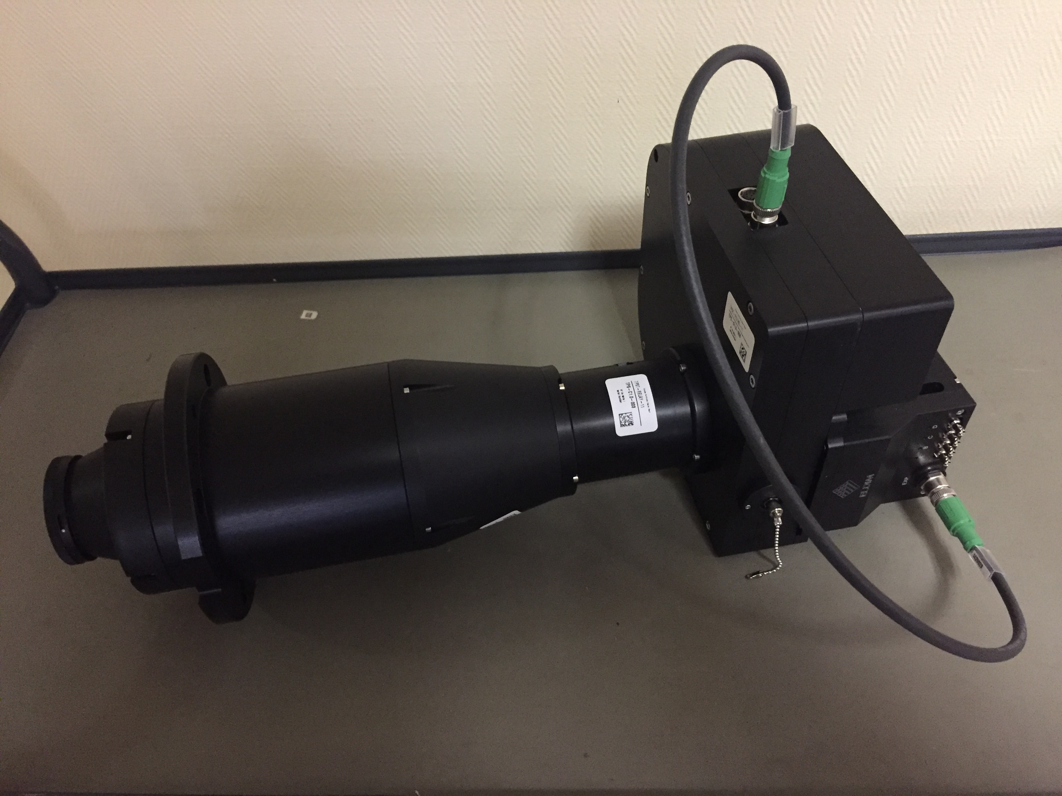
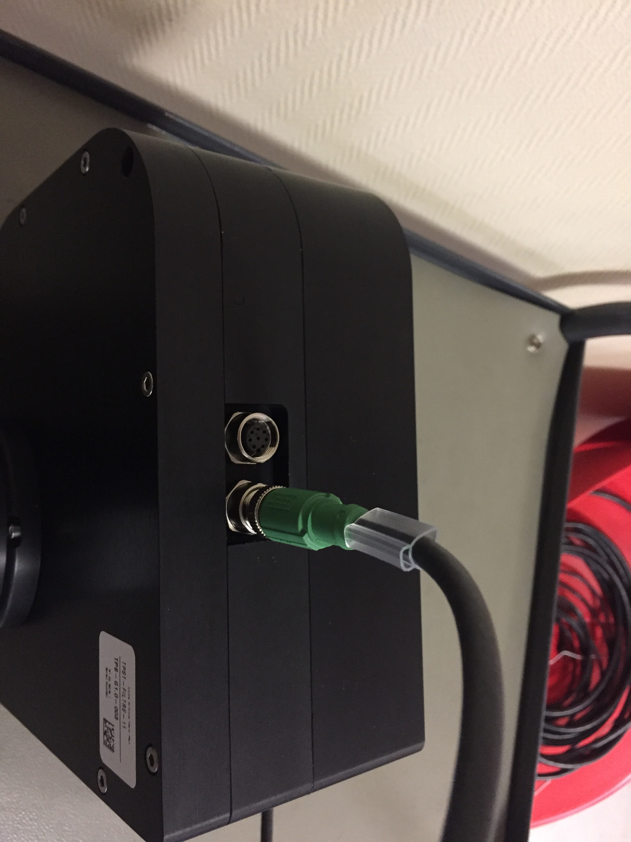
Taprisiot filter wheel connection
Connect the cable used to drive the filter wheels
Connect the cable on the camera side
Connect the cable on the wheel control side

Slide 5
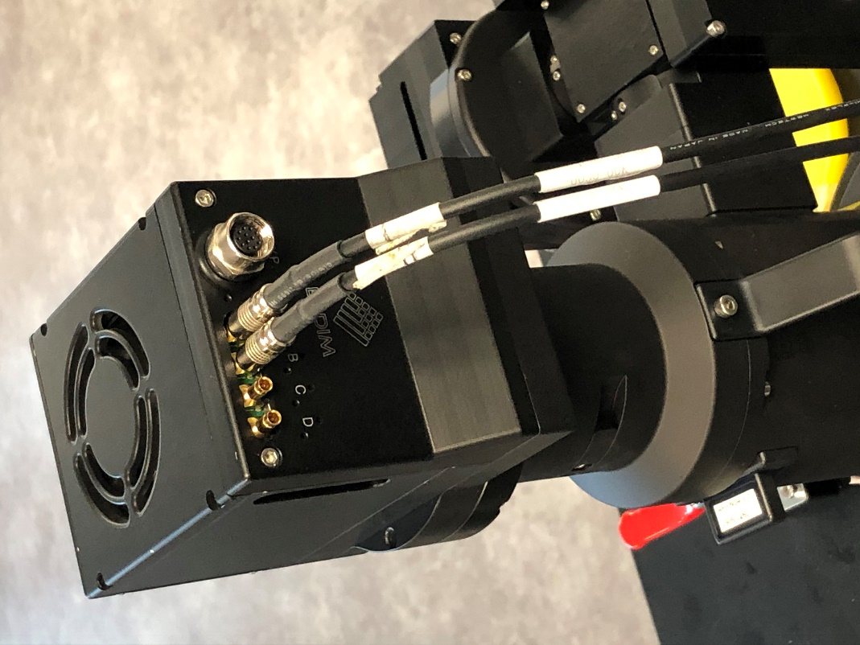
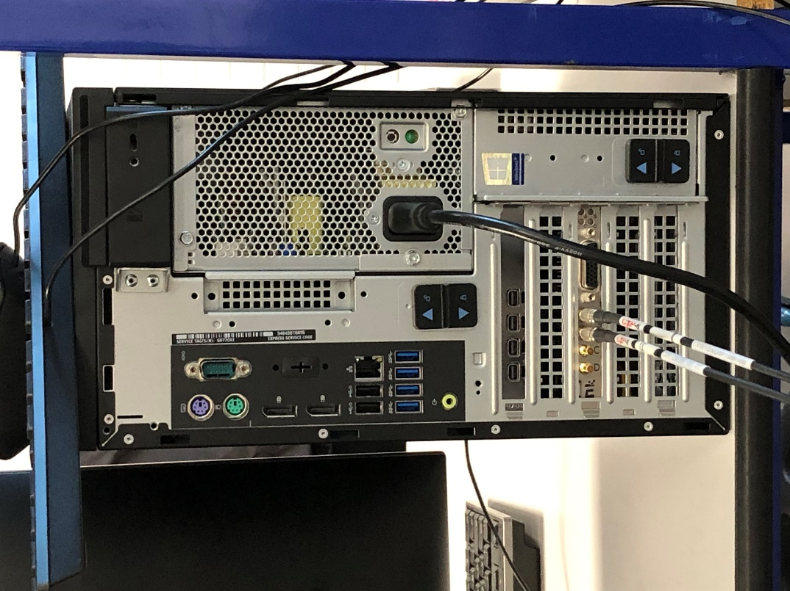
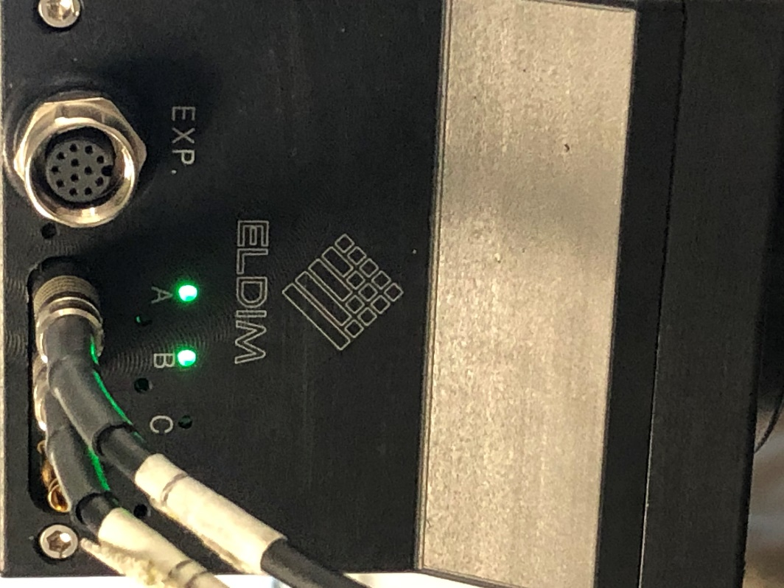
Connect Conoscope
The conoscope is powered by the Coaxlink cables.
Cable A
Cable B
Fixed light when
camera is started

Slide 6
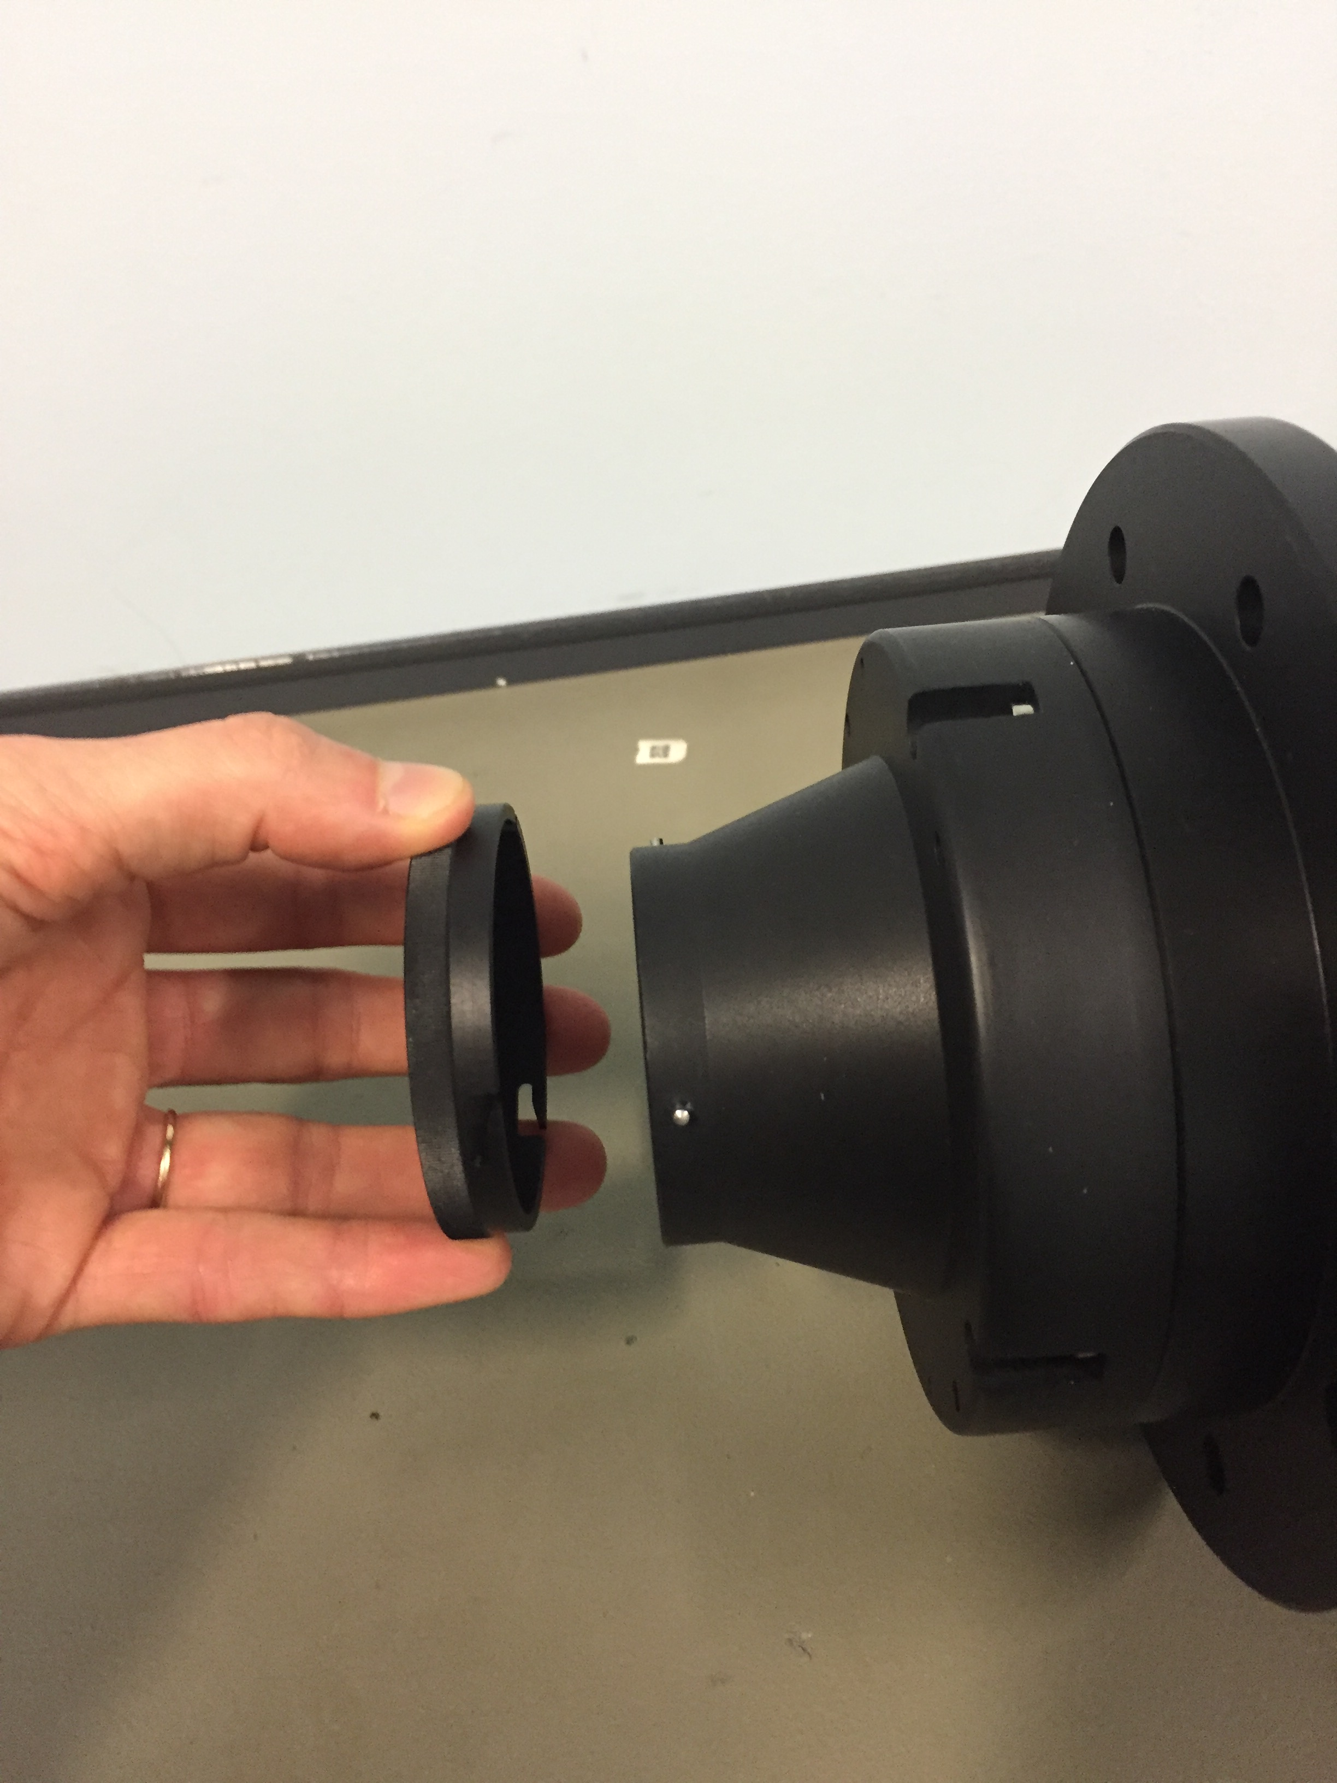
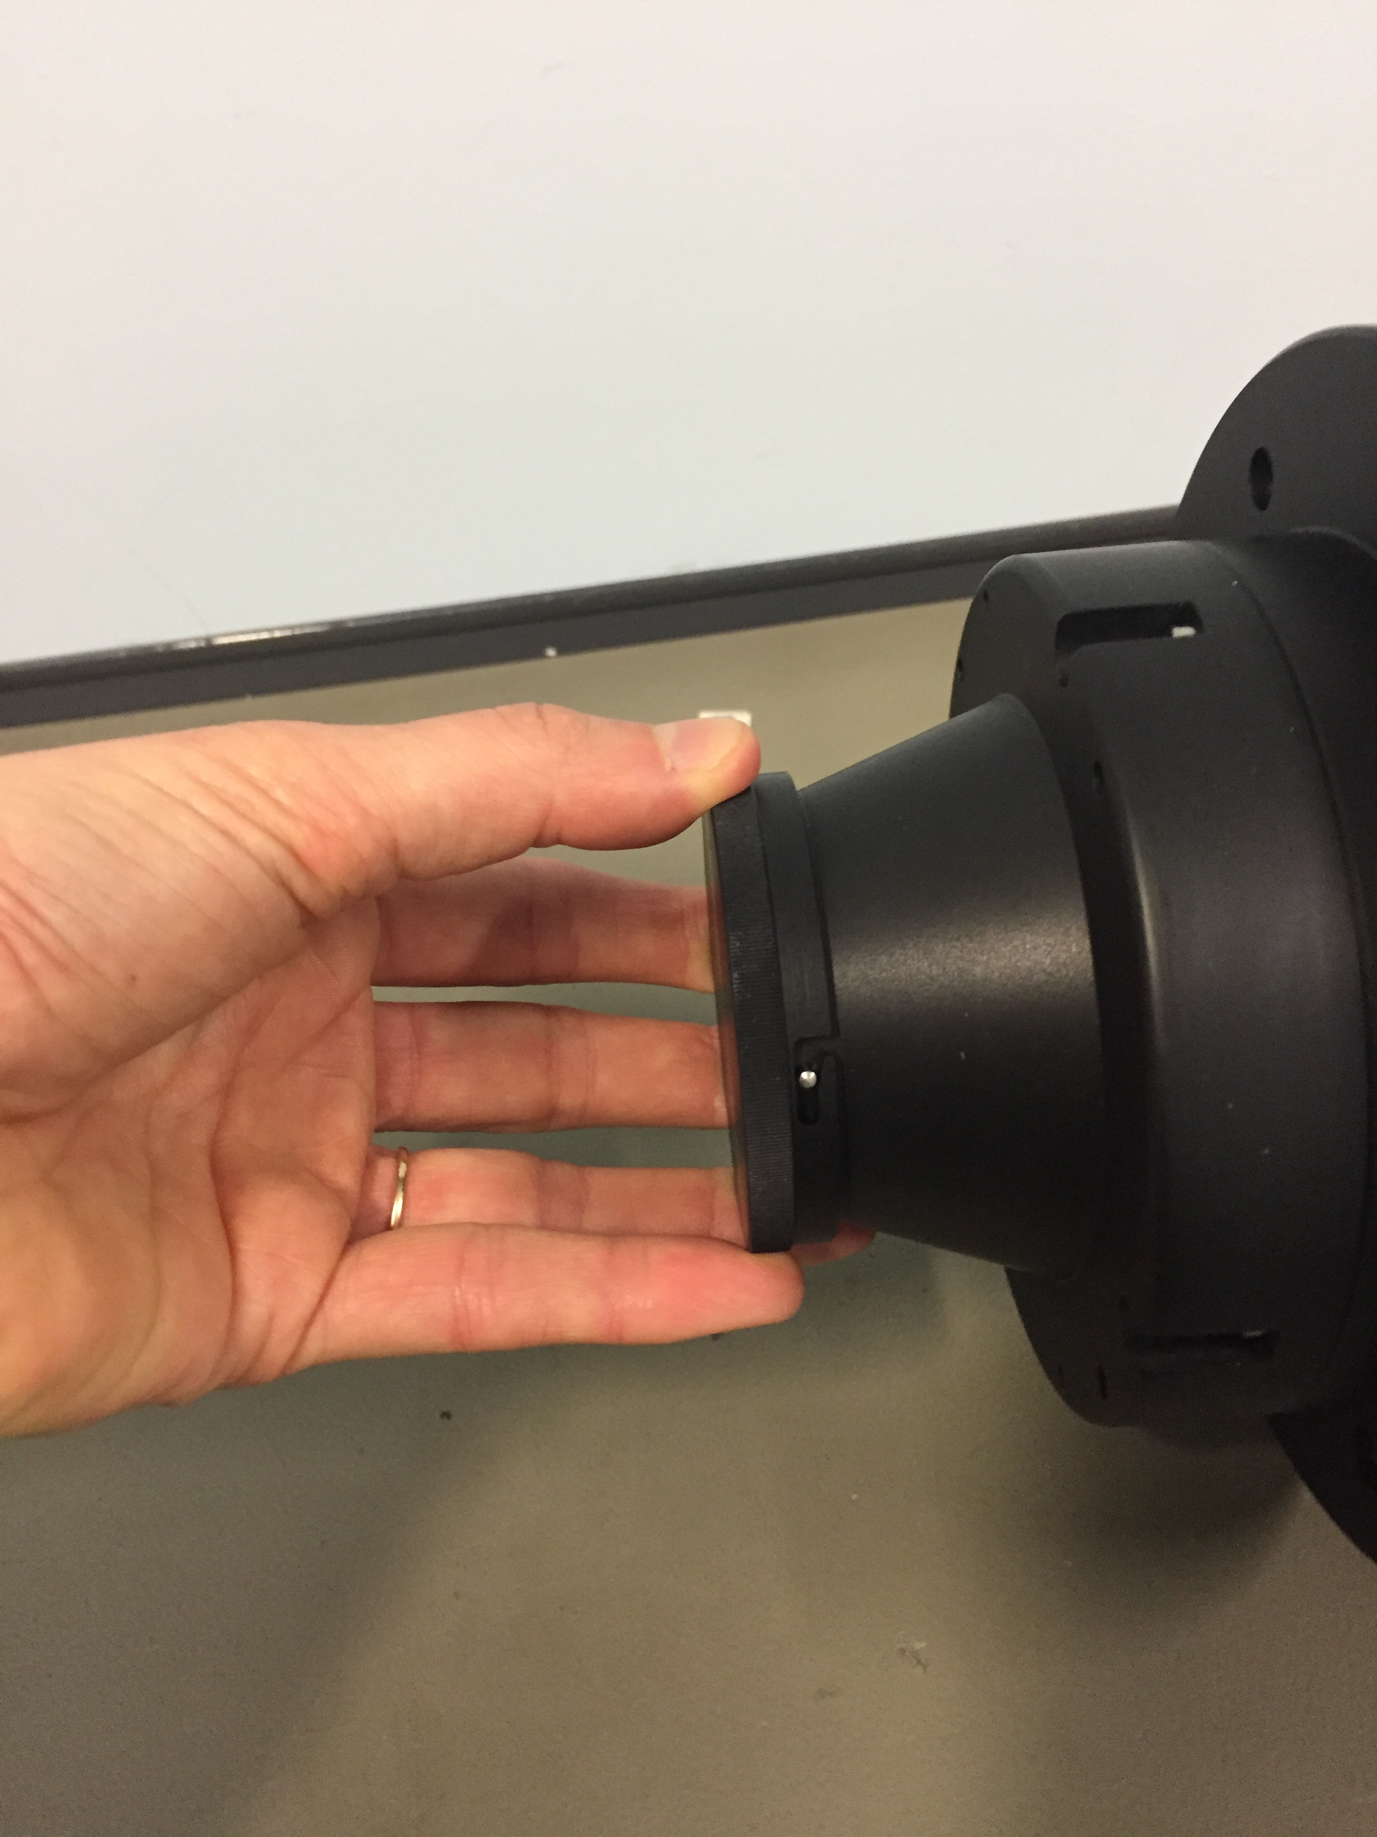
Removing the cap
Turn the cap until it can be released

Slide 7
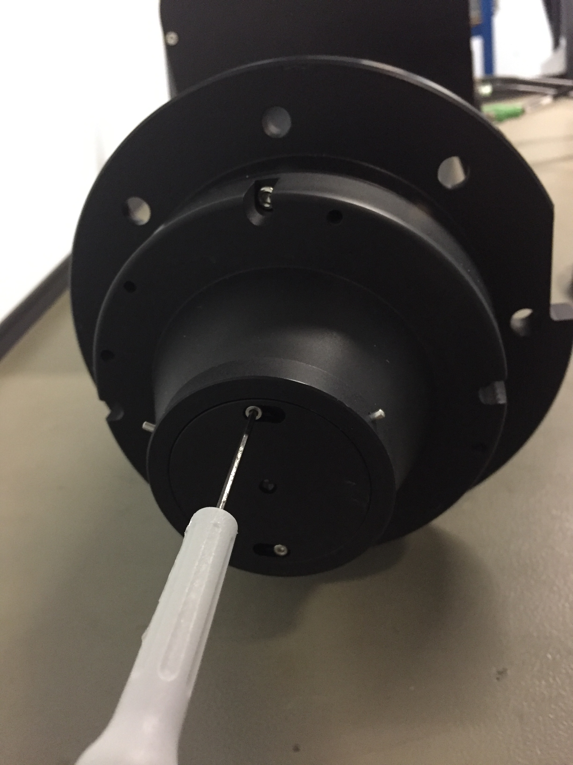
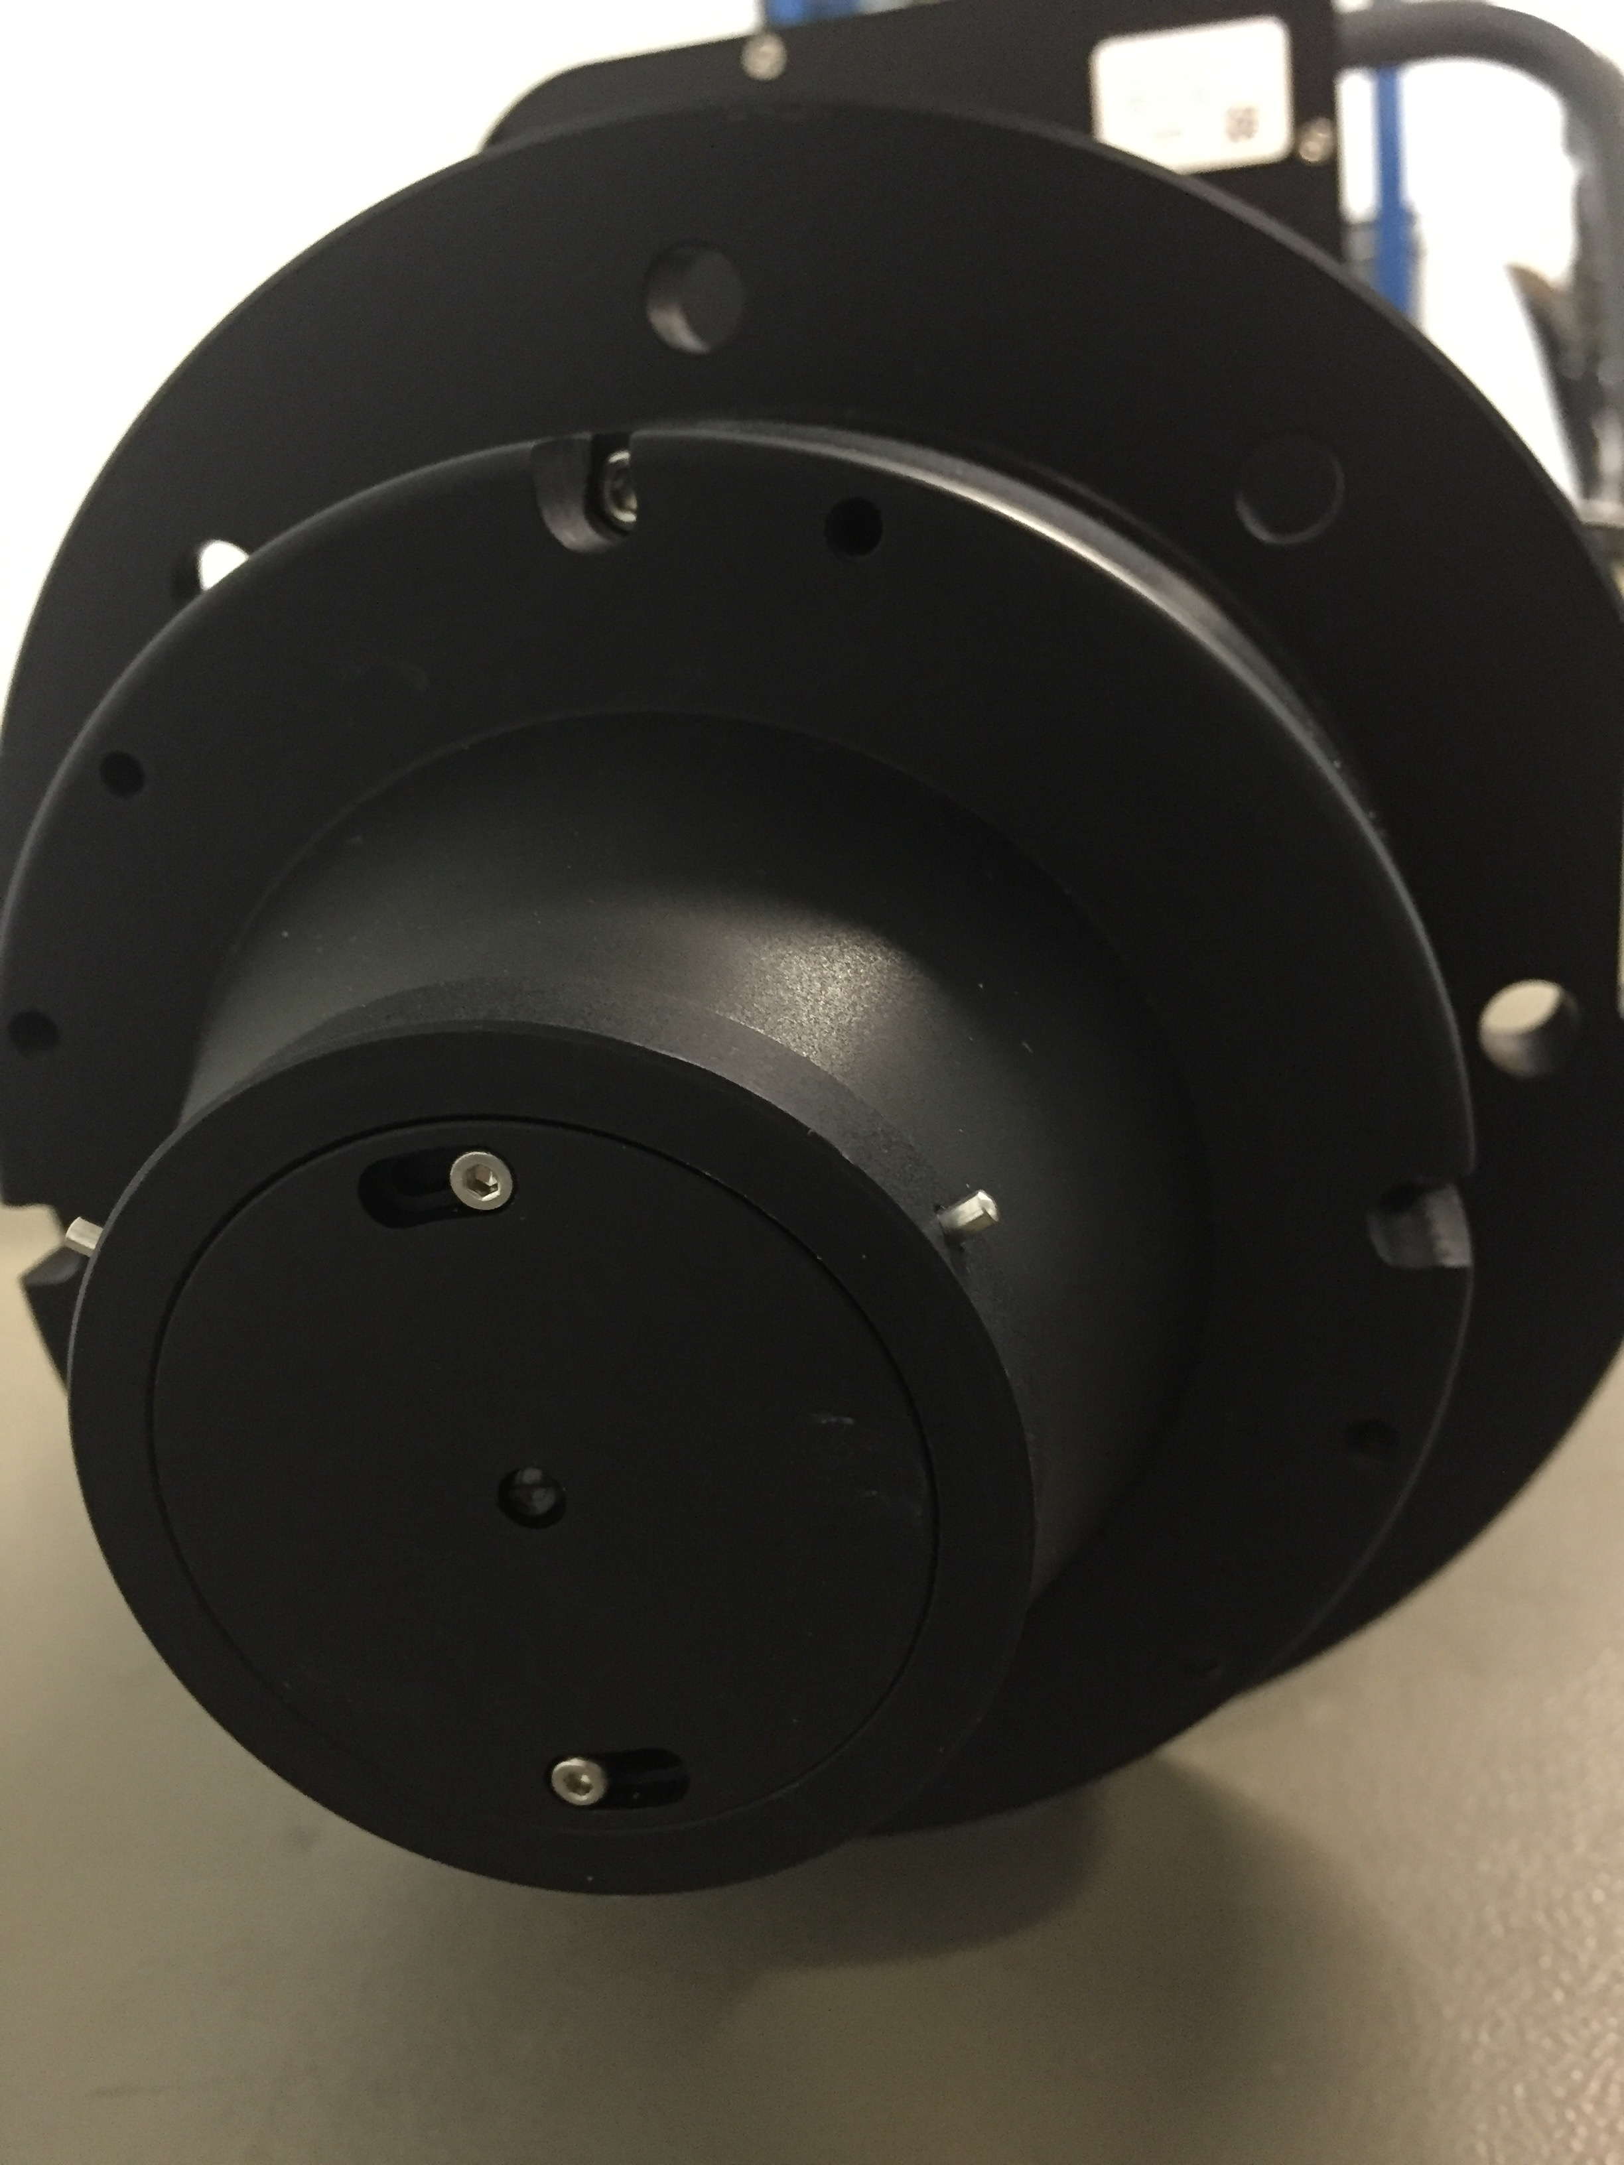
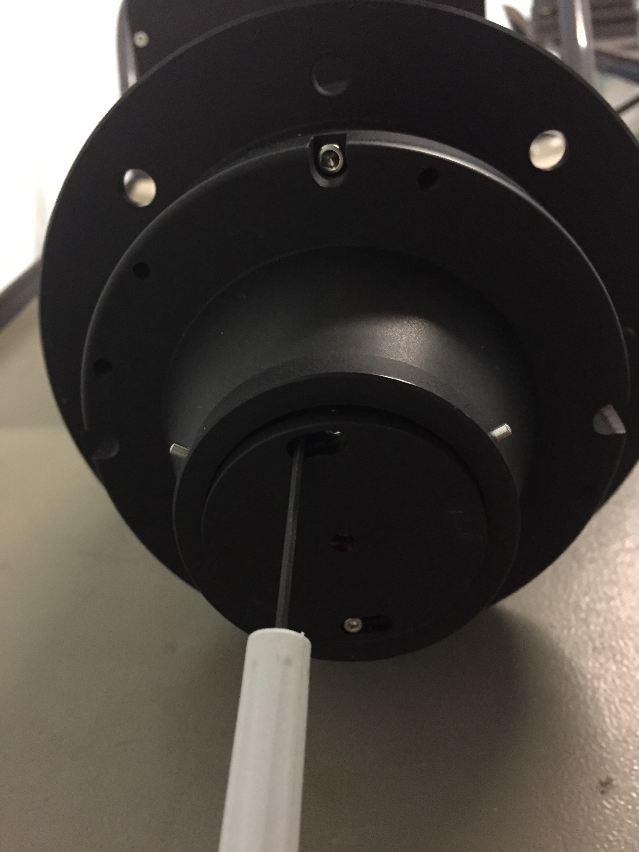
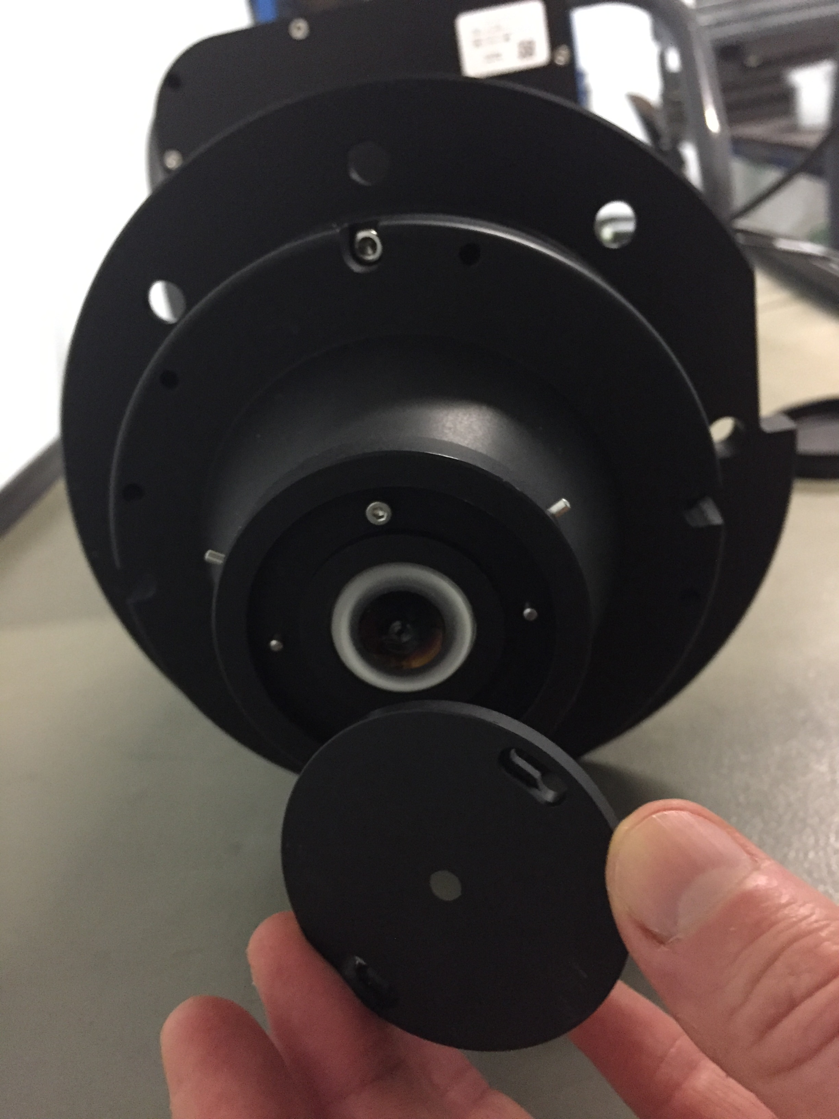
Changing the iris
Unlock the screws
but do not remove them
Turn the iris anti clock wise
Remove the iris with caution
Keep the lens clean

